Slide 1

AME 596
By
Priyanka Singh
Graduate Student
Department of Aerospace and Mechanical Engineering
PhD supervisor: Dr. Majid Beidaghi
AME 596

Slide 2



Optimizing MXene work function by varying the composition of MXene (Ti₃C₂T_{x}, Nb₂CT_{x} & V₂CT_{x}) for Supercapacitors with Bayesian Optimization
WORK FUNCTION?
MXene WF?
WHY WF?
1
2
3
The work function (Φ) of a material is the minimum energy required to remove an electron from the Fermi level of a solid to a point just outside the surface (the vacuum level)​
MXene are typically metallic or semi-metallic, so, their Fermi level lies within or near their conduction bands.
An optimized work function ensures that the MXene Fermi level is well-aligned with the electrochemical processes of interest. This minimizes the overpotential for charge transfer, leading to faster kinetics and higher power capability.
Principle of using termination-induced work function reduction has opened a pathway for MXene-based electron sources!
AME 596

Slide 3
OBJECTIVES
1
IDEA
complex materials design optimization problem with both continuous variables (mixing ratios) and categorical variables (termination types).
In particular, MXene (Ti₃C₂, Nb₂C, V₂C) can be mixed or alloyed to create composite electrodes with tailored electronic properties.
The challenge is to identify the optimal composition (ratio of Ti, V, Nb) and surface termination (O, OH, F, Cl groups on the MXene surface) that yields a “just right” band gap for maximum supercapacitor performance.
2
RESEARCH
An optimized work function ensures that the MXene Fermi level is well-aligned with the electrochemical processes of interest.
3
PLANNING
Literature and Database Mining, This literature-derived dataset provides a starting point without running new DFT – effectively leveraging previous research as training data.
4
DIVERSE INITIAL SAMPLING
Absence of any prior knowledge, one may simply choose a diverse set of compositions to sample as a starting point. Some BO tools can bootstrap with no initial data at all.
AME 596

Slide 4
MOTIVATION
1.
Conventional DFT (at the PBE level) underestimates band gaps
2.
Details could be chemically interesting, bond length changes
3.
Experimental Characterization like UPS, KPAFM
4.
Wave function directly influences charge storage and electron transfer kinetics.
AME 596

Slide 5
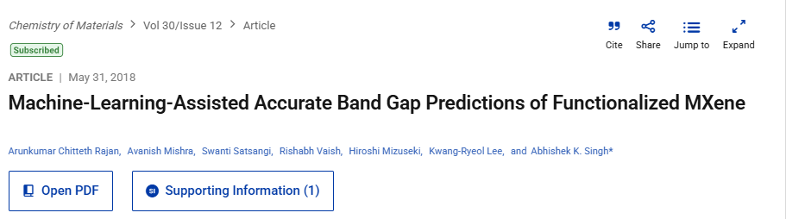
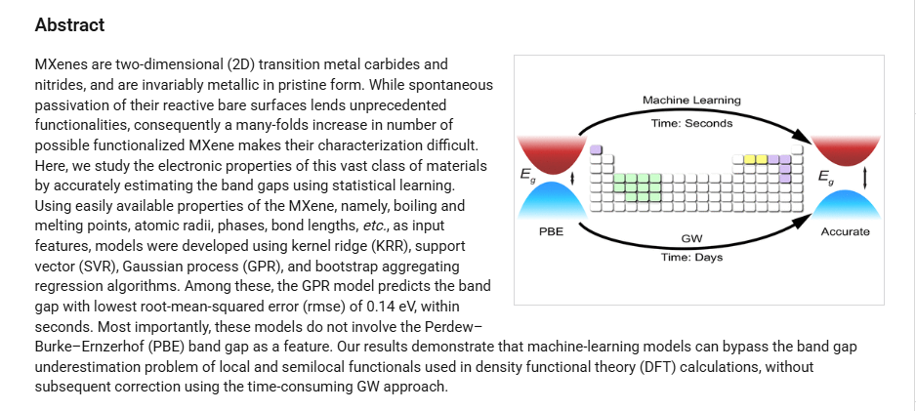
LITERATURE SURVEY
AME 596

Slide 6
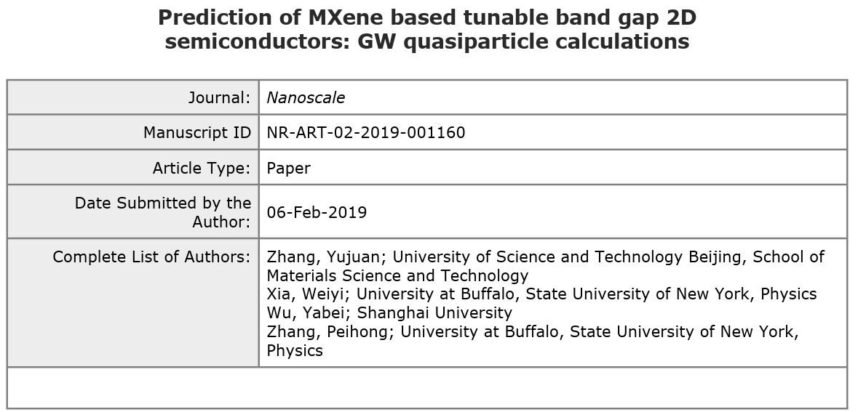
LITERATURE SURVEY
MXenes are a large family of layered transition metal carbide/nitride materials that possess a number of desired properties such as flexible chemical composition, high mechanical strength, and excellent structural stability. Although MXene based semiconductors have attracted considerable recent research attention in the search of novel 2D electronic materials, accurate understanding of their electronic properties has not been established. In this work, we carry out fully converged GW quasiparticle calculations for M2CO2 (M = Hf, Zr, and Ti) MXene based 2D semiconductors and alloys using newly developed accelerated GW methods. The quasiparticle band gaps of single-layer Hf2CO2, Zr2CO2, and Ti2CO2 are predicted to be 2.45, 2.13, and 1.15 eV, respectively. The narrow band gap of Ti2CO2 is attributed to the low energy of Ti 3d as compared with the Hf and Zr d states. Considering their chemical similarity, it is expected that Hf2-2xTi2xCO2 semiconductors can be synthesized without difficulties. We show that the quasiparticle band gap of Hf2-2xTi2xCO2 (0 < x < 1) semiconductor alloy can be continuously tuned from 2.45 to 1.15 eV, offering a unique 2D semiconductor with moderate and tunable gap for future electronics applications.
AME 596

Slide 7
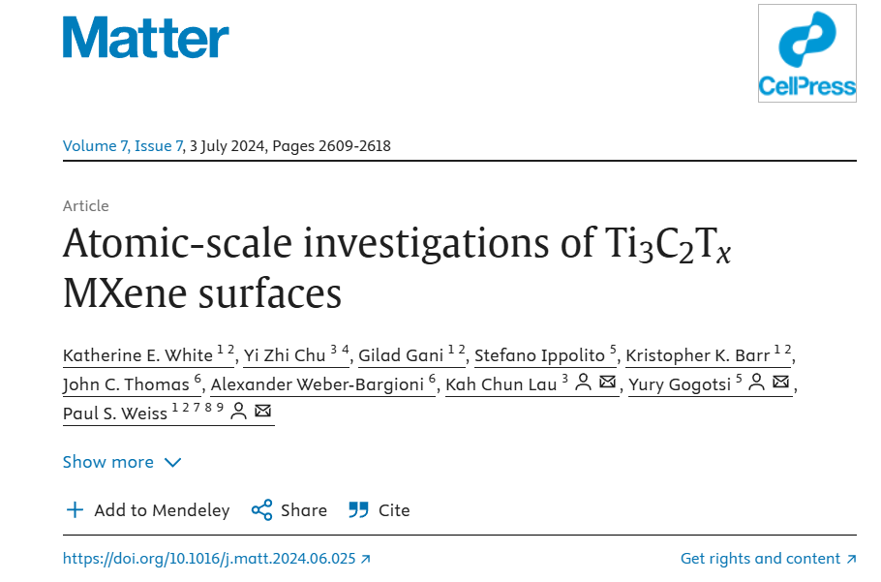
LITERATURE SURVEY
KEY POINTS:
Scanning tunneling microscopy and spectroscopy unveil MXene surfaces
The local electronic and physical structures of MXene are calculated and measured
Chemical composition of MXene surfaces strongly affects their properties
Terminal functional groups and oxide clusters on MXene are visualized and characterized
AME 596

Slide 8
Generate Synthetic Data: Simulates MXene compositions and corresponding band gaps using a mathematical function (since we don't have real data).
Train a Random Forest Model: Predicts band gaps based on (x, y, z) compositions.
Filter MXene Compositions: Uses the trained model to generate valid compositions with band gaps in the range 0–5.7 eV.
Outputs Optimized Compositions: Saves time by reducing the number of experiments needed before running physical tests.
If you want real DFT calculations, you need Quantum ESPRESSO (pw.x) or VASP installed on your machine.
Perform DFT calculations on the top predicted compositions for verification.
Trains a Random Forest model on synthetic MXene band gap data.

Slide 9
A major motivation for the work is that conventional DFT (at the PBE level) underestimates band gaps.
The authors examined 76 MXenes (from those that had a finite PBE band gap) and computed their more accurate quasiparticle
(G₀W₀) band gaps​file-xkszpppdktxvbbwodfdchp
. The comparison is stark: PBE-calculated gaps show very little correlation with the GW-calculated gaps​file
-xkszpppdktxvbbwodfdchp
. In other words, a material that appears as a small-gap semiconductor in PBE might actually have a moderate or large
gap under GW, and vice versa. This is illustrated by Figure S3b, which plots PBE vs. G₀W₀ gaps – the data
points are widely scattered rather than falling on a straight line​file-xkszpppdktxvbbwodfdchp
. Thus, relying on PBE gaps alone can be misleading, necessitating either costly GW calculations or a
predictive model to estimate GW gaps from easier-to-compute features.

Slide 10
As an example, consider one MXene: Y–Sc–C–Cl–OCN. Its band gap at the G₀W₀ level is about 3.40 eV, whereas PBE predicts only about 0.88 eV​file-xkszpppdktxvbbwodfdchp
. Many MXenes in the dataset show this pattern of severe underestimation – PBE often gives band gaps that are only a fraction of the true GW gaps​file-xkszpppdktxvbbwodfdchp
. The poor correlation means a simple linear correction to PBE gaps would not suffice; hence the need for a machine learning model to learn the relationship between material features and the GW gap.

Slide 11
PBE stands for Perdew–Burke–Ernzerhof, referring to the developers of a widely used exchange-correlation
functional in density functional theory (DFT). Introduced in 1996 by John P. Perdew, Kieron Burke, and Matthias
Ernzerhof, the PBE functional is a type of generalized gradient approximation (GGA) that improves upon the
local density approximation (LDA) by incorporating the gradient of the electron density. This enhancement
allows for more accurate modeling of electronic systems, making PBE popular in computational chemistry
and materials science due to its reasonable
accuracy across a broad range of systems without relying on empirical parameters
Generating an Initial Dataset without Direct Data
Literature and Database Mining:
Diverse Initial Sampling:

Slide 12
Gather Proxy Data & Features: Start by assembling a small but information-rich dataset.
Use literature and databases to find any known properties of MXenes or similar 2D materials that relate to the
wave function (e.g. work function, band gap, electron density distribution). Augment this with a few points
from a simplified quantum model or empirical estimate if possible. The goal is to obtain at least a rough target
value for a variety of compositions. At the same time, define a set of input features to represent compositions –
for MXenes, you might include element properties (like M’s atomic number, X’s electronegativity, etc.), composition
ratios (e.g. M${2}$X vs M${3}$X$_{2}$ type), and any surface functional group if relevant. Ensure these features are
derived from known data or periodic table constants so that “no additional first-principles calculations” are required
to compute them​dr.ntu.edu.sg
. This step yields an initial training table of feature vectors (composition descriptors) and target values
(proxy wavefunction metric).

